Slide 1
Surviving college…while having a blast!
Alexis Hurdle
ahurdle@astate.edu

Slide 2
2 Topics
Surviving College: The Academics and Professional Side
Surviving College—The Social Side

Slide 3
Before we Begin…
Laid back & informal atmosphere
Open & honest--YOU CAN ASK ANYTHING!!
Interactive—you take it in any direction
This is all stuff I’ve learned from experience. It’s ok to disagree with me!

Slide 4


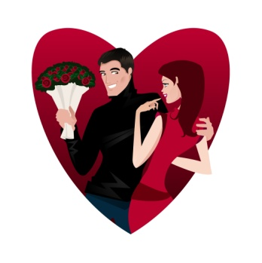

What I wish I had known:
You learn what studying really is.
Organization, Organization, Organization
Our beliefs will be challenged.
We will be exposed to some crazy stuff!
Professors want you to succeed, but they don’t make exceptions like high school teachers.
LOVE WHO YOU ARE
You are a prize

Slide 5

Surviving College: The Academics & Professional Side Part I

Slide 6

YOU GOT ACCEPTED!!!
Now What???
The Freshman Freak-Out is NORMAL
  We all react differently and experience different emotions: fear, anxiety, excitement, sadness, happiness, uncertainty, etc.
  All of these emotions are healthy and normal. Don’t worry yourself with your emotions.
    Crying doesn’t mean you have made a bad decision!!
  This is a NEW transition. Change is hard. Let yourself experience the emotions that come with change.

Slide 7



CLASS TIPS
Rustling Around Before Class Dismisses
SKIPPING CLASS
CHEATING
BACK ROW
TEXTING
Dress/Appearance/Smell

Slide 8
CLASS TIPS CONTINUED
Your Academic Advisor is your friend, but completing your degree requirements is YOUR job.
Always check your campus email daily
The syllabus—know it!
Making your class schedule—7:30AM?
  MWF—50 mins…..T/Tr—80 mins
  Don’t take challenging courses your 1st semester
  Decipher the course codes—ENGL 1013
Notes:
Email—forward into your primary account if don’t like checking 2 emails. REPLY TO EMAILS! (more on composing appropriate emails later)!
1st day of every class is “Syllabus Day.” This is often considered a blow off time, but it’s super important. It’s when you get a feel for your professor’s individual style. Do they have an open door policy? Require appointments? Attendance policy? Grading scale? Preferred means of communication. Get your syllabus and IMMEDIATELY put it into your phone calendar or daily planner—more on the importance of this later!
Making your Schedule: if you procrastinate you’re stuck with the early or late classes. Get advised early! Review with your advisor/on your own Prequisites for classes and when some classes are offered. 1st semester—regardless of what anyone tells you do NOT take challenging classes. Allow yourself a semester to get your feet wet and find a system that works.

Slide 9
ORGANIZATION, ORGANIZATION, ORGANIZATION!
Start Day 1 Organized
THE DAILY PLANNER!!!!!!!!!
Good padded backpack
Books for class are $$$
  Find what books you need after registration
  Put your shopping skills to the test!
    Half.com; iBooks; amazon.com….
3-ringed binders for each of your classes
  Dividers
  Paper
Keep track of your grades to prioritize your studying.

Slide 10
Do you know how to study?
DO NOT cram! (90-95% of you will still do this).
Read your notes daily (90-95% of you will NOT do this).
Treat class like work—carve out time each day to focus on homework/studying
Professors don’t care about your schedule.
Find a method that works for you:
  Group study sessions, coffee shop, quiet library room, teaching it to yourself, rewriting notes
Reward yourself!
Notes:
Cramming is stressful and ineffective
Reading your notes daily sounds awful and boring but it WORKS. Countless studies have shown that reading your notes at least 24hrs after first writing them increases your comprehension by 60%!!! When you keep reading them each day you only increase your comprehension, making studying easier.
Carve out time and STICK TO IT! Write it in your planner. Tell people you’re busy if they tempt you with something more fun.
Unlike high school, college professors don’t care that you have 2 tests on the same day as his test…or that you have a huge project and 5 tests next week. This is why planning is important. You WILL have weeks where it feels like every professor is giving a test.
Are you a visual, auditory, or kinesthetic? I’m mostly auditory with some visual.
Give yourself incentives—get your friends to join in with you as accountability! “We will study for the next 2 hours and then watch a movie/go shopping.”

Slide 11
Surviving college: Academics & Professionalism part II:
How to stand out!!

Slide 12
Professionalism Tip #1:
Getchu a resume!
College apps, scholarship apps, involvement apps and registration
Find a format you like—ask professionals for theirs, email me for mine!, Google…
High School GPA, ACT score, community service involvement, leadership experience
Keep updating it!

Slide 13
Professionalism Tip #2:
Recommendation Letters
Advance notice on Rec Letters (at least 1 week)
  Resume
  Copy of application/requirements
  Follow with a thank-you letter

Slide 14
Professionalism Tip #3:
Thank you notes
NEVER underestimate the power of a thank-you note.
Get yourself some stationary, thank you cards, etc.
Hand deliver or mail
Appropriate format:
  Greet the giver
  Express your gratitude
  Discuss use (“The graduation money will go into my college savings!”)
  Mention the past; allude to the future (“It was great to see you in church on Sunday. I hope to see you when I come home to visit.”)

Slide 15

Professional Tip #4
PROFESSORS/ADVISORS AREN’T SCARY ALIENS!!!
How to Schedule Appointments
How to Talk to your Professor
How to Type Professional Emails

Slide 16
Which Letter to Use???
Hey I don’t understand what’s going on in class and I can’t fail because I have a scholarship and my mom wants me to drop it but just don’t know what to od. ☹ I need to meet with you asap because I need you to help me know if I should drop the class or keep trying my hardest. I have to do good b/c my gpa is so important for nursing school and I wont get in unless I have at least a 2.75. ?!?! I need you to tell me when you can meet with me.
Thx ☺
Hi Alexis/Dr. Hurdle/Mrs. Hurdle,
My name is Barbara Bush, and I am a student in your Fundamentals of Chemistry class that meets on T/R at 7:30am. I am emailing you because I am concerned about my success in the class. I am a dedicated student majoring in Nursing. As you probably know, my GPA is so important to me as I prepare for Nursing School. I was wondering if I could meet with you, at your convenience, to discuss my concerns. I look forward to your reply.
Thank you,
Barbara Bush
002259644 (student ID #)

Slide 17

Professionalism Tip #5:
THE HANDSHAKE
BEWARE the Dead Fish!!!!!

Slide 18
QUESTIONS ON Academics & professionalism?!?!

Slide 19
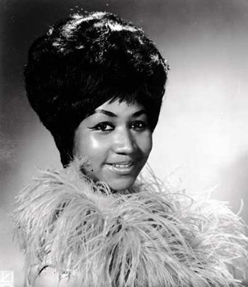
Surviving College: The Social Side
RESPECT YOURSELF!

Slide 20
Here’s what’s coming up…
Get involved!
Own your values
Self Presentation/Social Media
Own your rockin’ bod!
Relationships

Slide 21
Freshman year!!!
GET INVOLVED!
  Offices of Student Involvement
  Greek Life-fraternity and sorority life
  Religious organizations
  Political organizations- Young Democrats/Republicans, Student Government
  Social organizations-Habitat for Humanity, Colleges Against Cancer
  Intramurals
  Make NEW friends!!! These friends last.
Notes:
Fraternities/Sororities—truly do create a home away from home. Email me if you have ANY questions!
Religious orgs—highly recommend! Our beliefs are what we use to explain what’s happening in our world. It’s how we make sense of everything. It’s our core understandings and beliefs. In college this can be so crucial to find this support b/c no matter how big or how large a college you go to your beliefs WILL be challenged—and that’s ok and it’s good!—but it’s also nice to have a support group of people who see the world as you do.
Make NEW friends! It’s great if you’re going to college with a current friend or group of current friends, but you will really be missing out if you don’t let yourself meet friends that are ONLY YOUR FRIENDS. If you’re going to college with a current “best” friend then have a conversation with that friend about how you hope to continue this friendship/how much this friendship means but how you hope you can each make your own new friends, too! NOTE: in small high school you don’t get to pick your friends…in college you do!

Slide 22
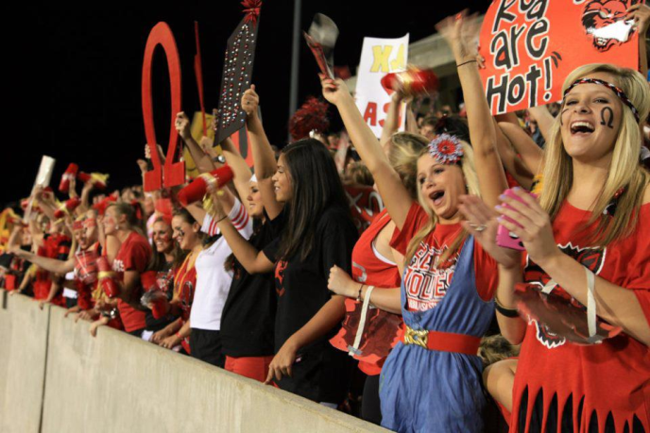


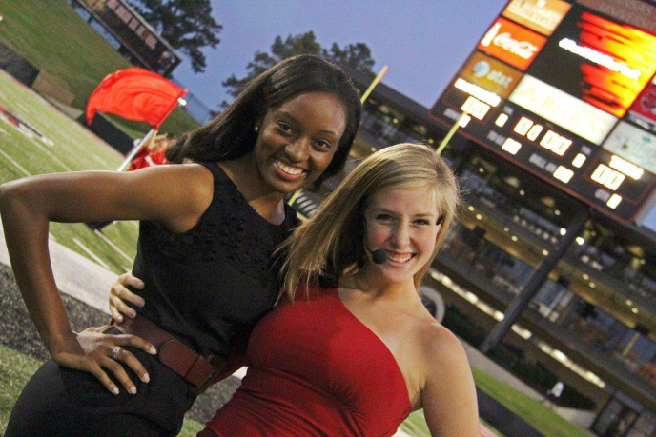
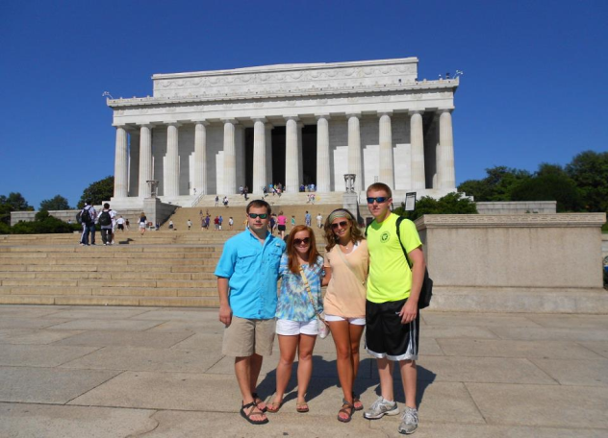
COLLEGE can be THE BEST 4 yEARS of your life!!!!
Notes:
College is awesome! You are free to determine who you finally want to be. No more high school pressure to be fake. You get to be YOUR TRUE SELF! You can go to fun sporting events, you can go to fun parties, you can study abroad, you can go on fun and free field trips across the nation, you can get involved, you can make the best friends of your life!!! You can leave feeling so good about yourself and who YOU are!

Slide 23
Or…it can be the worst…
Notes:
What are you going to do with your freedom? Successful people in college put academics first but have a whole lot of fun and can still party. The catch is that they set self-imposed boundaries. We’re going to talk about that here…

Slide 24



Your Beliefs will be challenged…own your values!
Think about your beliefs toward issues…set self-imposed boundaries!

Slide 25
What is Self-Presentation?

Slide 26


How are YOU Presenting Yourself???
Notes:
What are some things you have seen on facebook or twitter that make you wonder why they thought that was a good idea?

Slide 27
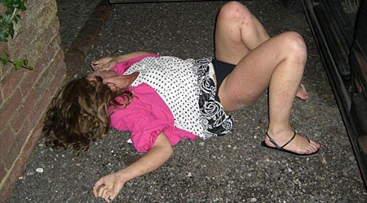
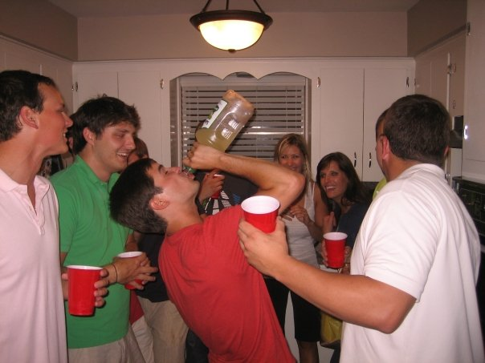
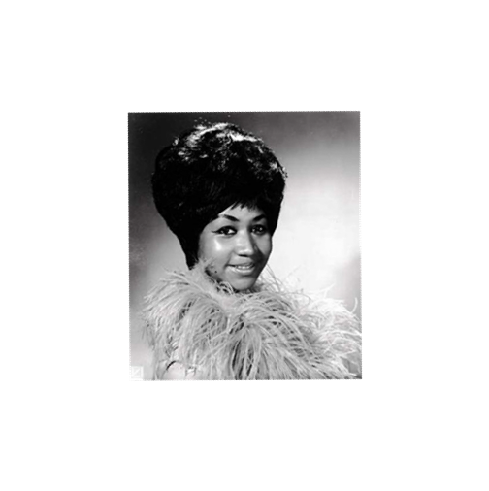

Slide 28
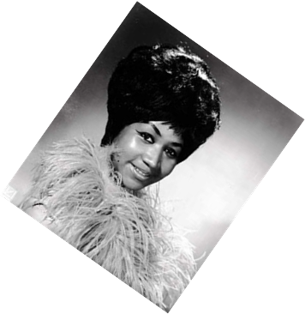


Do you know who is checking it?
The Internet is timeless; a photo you post on Facebook will probably out live you.
Easy with the status updates: rants, dramatic posts, (more on this later)
Be careful with the “check-in feature”
Help end social media bullying
Don’t let it consume your life!
  Call someone, send a snail mail card, hang out in-person!
Social Media & Beginning Stages of Dating =
Utilize your privacy settings! But, remember, nothing posted online is ever 100% private.
  Just say “NO” to sexting!!!
  Rule of thumb!
Notes:
Do you know who is checking it? Professionals check this all the time! Professors, our office checks it for applications, employers even check it!
*Story of profile pic and obituary
RULE OF THUMB: NEVER type or write or post anything that you wouldn’t want everyone to see! Don’t send it in an email, a fbook message, a chat, an IM, a text, etc! NEVER EVER EVER!

Slide 29
Own Your rockin’ bod!!
In 2004 and 2005 a study done by Harvard University asked women how they perceived themselves. When asked if they considered themselves beautiful, only 2% said yes. That is only 64 out of 3,200 women.
54% of women surveyed said they’d rather be HIT BY A TRUCK than be fat.
81% of 10 year olds survey that they are afraid of being fat.
More women are suffering from eating disorders than BREAST CANCER.
40% of mom’s tell their daughters to lose weight.
A little closer to home?
  Out of 200 ASU female students, 90% said they have recently HATED the way they looked.

Slide 30



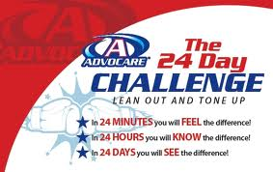

Who society says you should be…
Notes:
Show airbrushing video

Slide 31
Who you say you are…
Notes:
Point to yourself. You point to your heart. Not your….. Or…….
A lot of times we are our own biggest problem…but were also our solution. We have to fight for ourselves! How? We have to work to end “fat talk.”

Slide 32
Stop fat talk!!!
Notes:
Show video of Fat Talk.

Slide 33
relationships
Stick to YOUR OWN timeline!
1 of 2 outcomes in every relationship
You are a PRIZE—
“Sex appeal is 50% what you’ve got, and 50% what people think you’ve got” –Sophia Loren
  Be a strong woman--90% of men agree!
    Kind yet strong
    Is a mental challenge—the guy never feels he has 100% hold on her.
    Has a subtle strength
    Doesn’t give up her life
    Doesn’t chase a man
    She’ll stand up for herself and her values when he steps over the line
    Success in love isn’t about looks—it’s about attitude.

Slide 34
Doormat vs. Strong Woman
“I’m Not Enough” | “I’m Enough. Take it or Leave it
She calls him often and says, “please return my call.” | She gets back to him when she’s free.
She is on call like a rookie flight attendant. | She sees him when it’s convenient for her.
She makes it obvious a relationship is her goal before she knows much about him. | She goes out to have fun and doesn’t make promises to a virtual stranger.
When he does call her, she is mad he didn’t call sooner. | When he calls her, he is curious where she is, and why she’s not there.
She often drives. | He’ll pick her up or happily go out of his way.
She asks, “Where’s our relationship going?” | He has no clue where the relationship is going, and she leaves it like that.
She talks about having babies. | She can’t remember his last name.
She asks him about the “ex.” | He brings up the ex; she looks at her watch.

Slide 35
He vs. She
In Her Mind | In His Mind
“I’m going the extra mile.” | “She’s trying too hard. She’s desperate.”
“I don’t wanna play games.” | “She talks too much.”
“I’m nurturing.” | “She’s mothering.”
“I’m giving 100% so I can make it work.” | “She is REALLY nice, but there just isn’t any chemistry.”

Slide 36
Top 10 List…
Notes:
Top 10 list from Delicious.com

Slide 37
QUESTIONS?!?!

